Slide 1
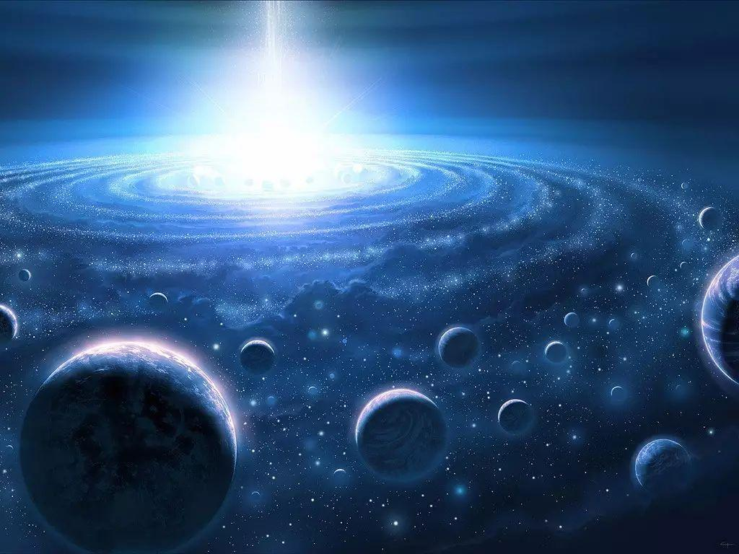
Moon that you don‘t know
你不知道的月球

Slide 2
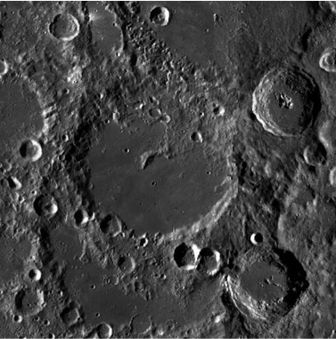
我们一般觉得月球的背面是月球的黑暗面，可是月球的背面还比月球的正面亮一点。
Usually we think the back of the moon is more dark than the face , but this is wrong because it is more bright than the face of the moon.
冯。卡门环形山
Feng crater

Slide 3
Demo1click to start

Slide 4

请点击我click me
点击返回click to go back

Slide 5
Thank for watching
点击返回首页 click to go back the first page

